Slide 1
Channel Estimation Using Deep learning in Underwater Acoustic Communication Systems
Members
Abhiram 17EC117
Ajay Bingi 17EC210
Sunnyhith Yadlapalli 17EC154
Under the guidance of
B Nagavel Assistant Professor,Nitk

Slide 2
Problem Statement:
Proposing a Deep Learning Model for the accurate Channel estimation In Underwater Acoustic Communication systems
Motivation :
Underwater Acoustic (UWA) communication faces a lot of hurdles such as environmental characteristics, variety of noises, temperature, pressure, salinity, etc which makes the UWA channel unique.

Slide 3
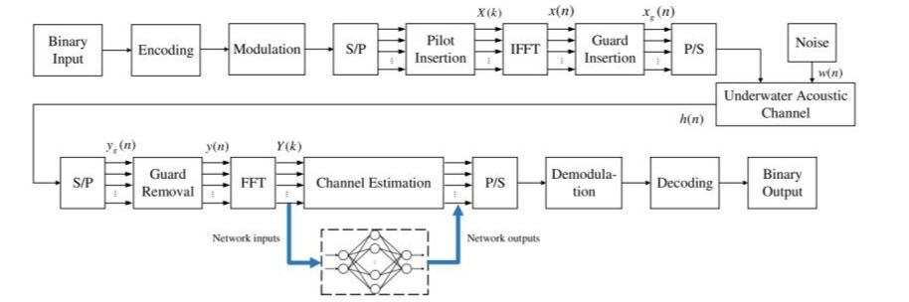
Block diagram of UWA-OFDM system model.

Slide 4
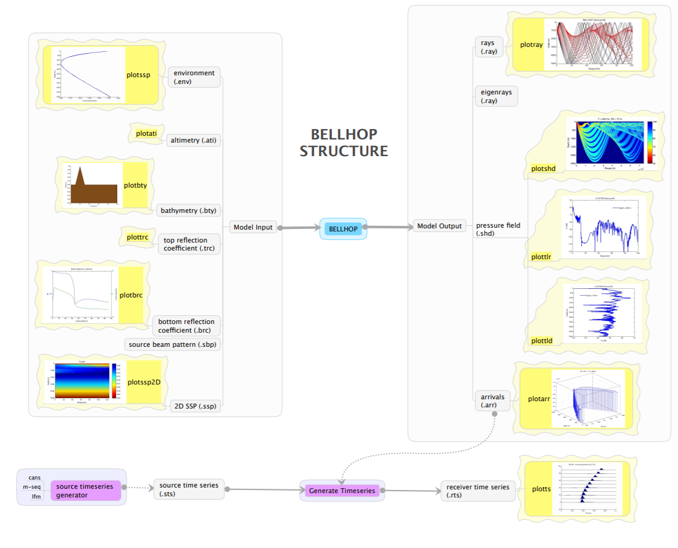
Bellhop Ray Model

Slide 5
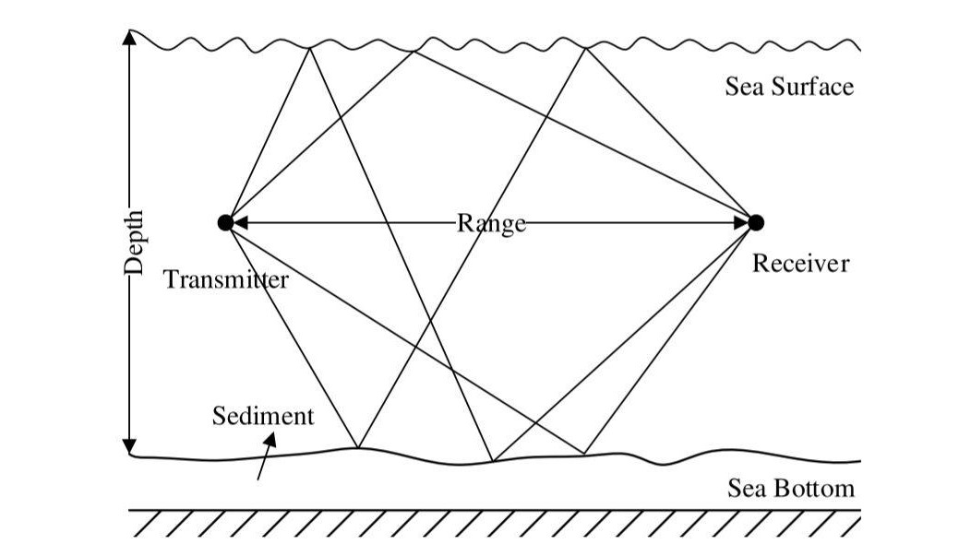
BELLHOP ray model of a shallow UWA multipath channel
Environmental factors including the variation of sound speed at depths, shapes of sea surface and bottom, boundary reflection and scattering, and geometry of the transmitter and receiver are considered in this model.

Slide 6
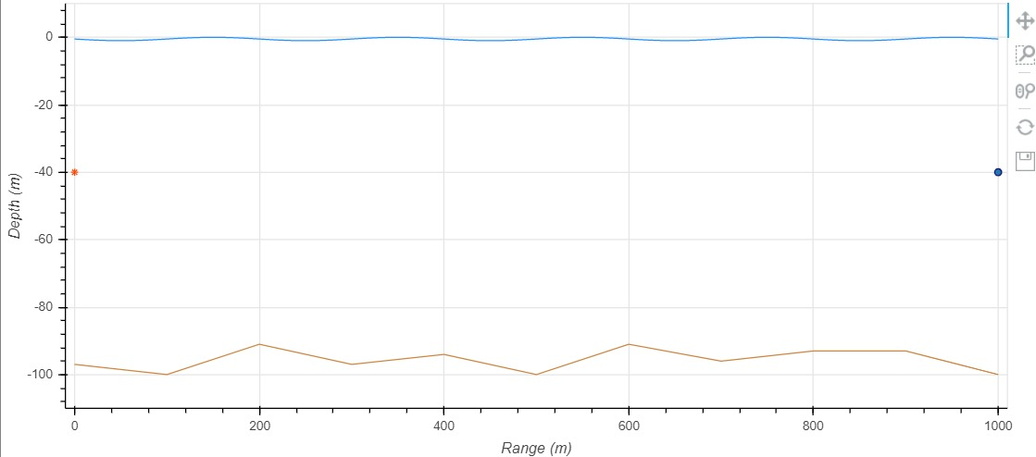
Simulations after using Bellhop Ray Model
Assumed Underwater Environment Model

Slide 7
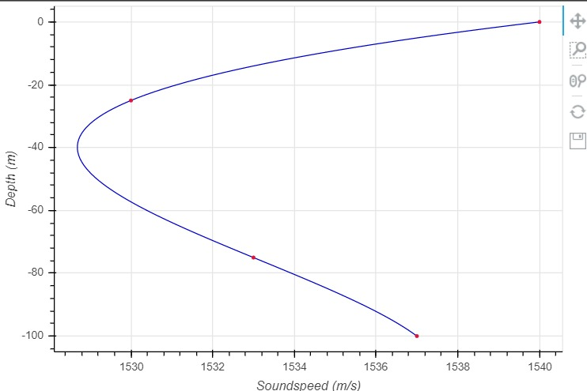
Sound Diagram

Slide 8
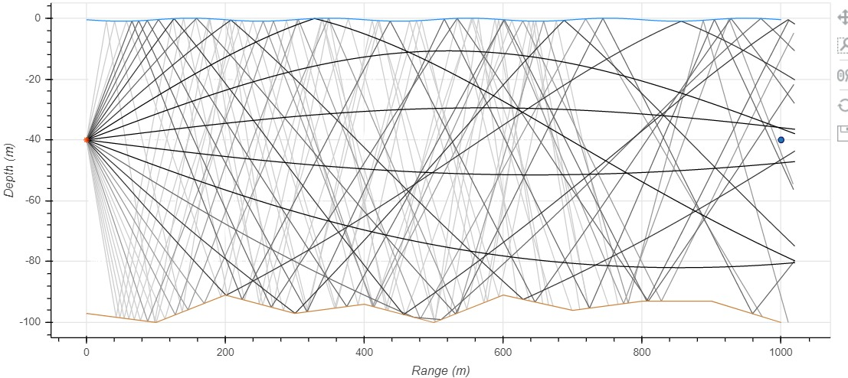
Computed Ray Diagram

Slide 9
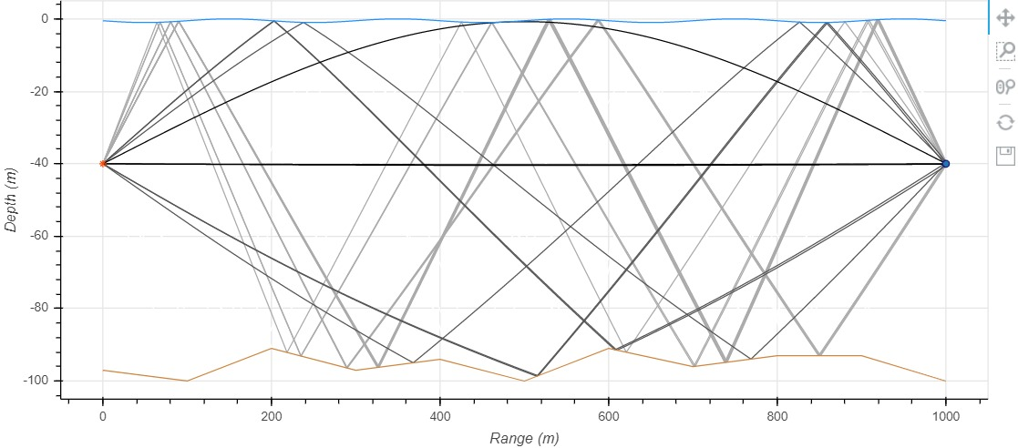
Eigen Rays Diagram

Slide 10
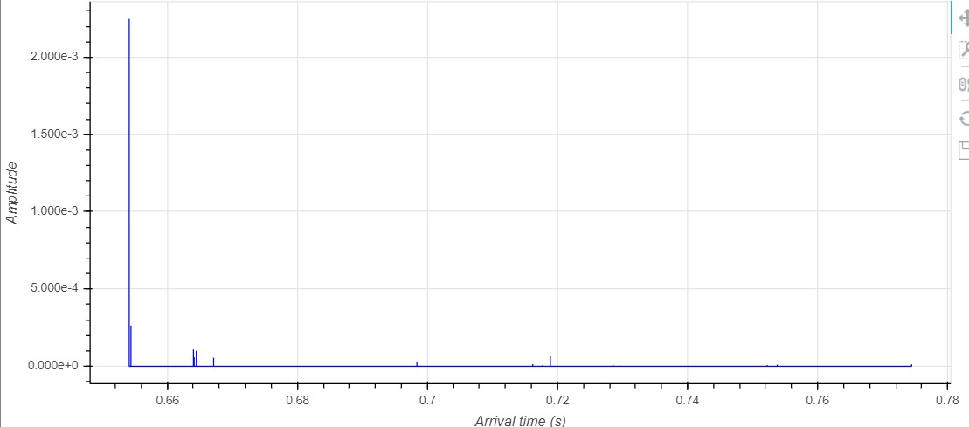
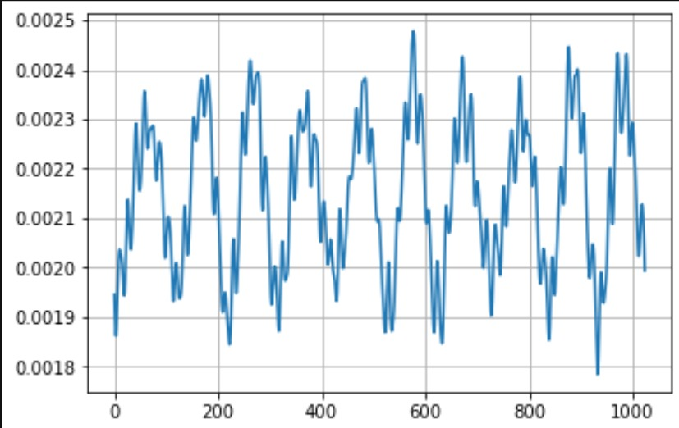
Impulse Response Showing Arrival time Impulse Response in Frequency domain

Slide 11
Block diagram of UWA-OFDM system model.

Slide 12
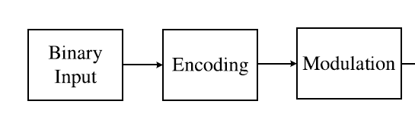
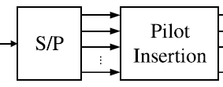
the binary data sequence is firstly encoded and mapped with QAM modulation schemes
The modulated signal is converted from serial to parallel ones
the pilot tones are inserted to estimate the CIR of the channel model.

Slide 13
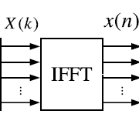
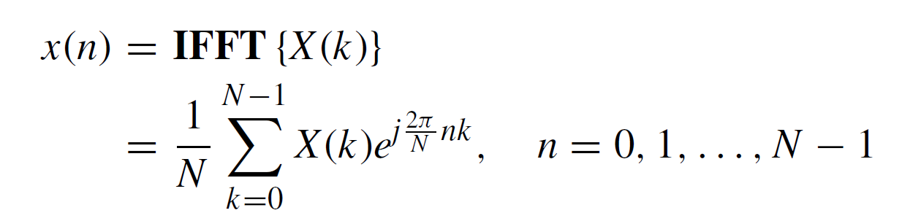
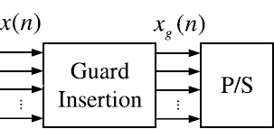
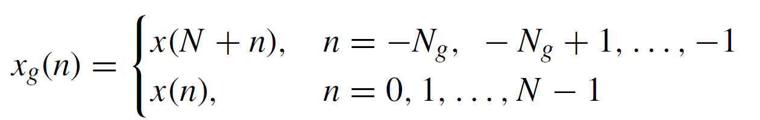
In the UWA-OFDM system, the parallel data are transformed by inverse fast Fourier transform (IFFT) with N orthogonal narrowband subcarriers
The time domain signal x(n) is obtained from the frequency domain signals X(k) as follows:
Parallel subcarriers are converted to a serial bitstream and the cyclic prefix samples are inserted as guard intervals to alleviate the ISI
So the time-domain transmitted signal including cyclic prefix can be represented as follows:

Slide 14
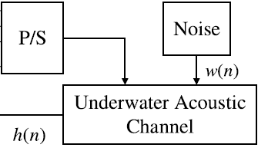
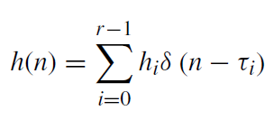
After passing through the underwater acoustic channel, the received signal yg(n) is given by
the operator ⊗ corresponds to the circular convolution and w(n) is the additive white Gaussian noise (AWGN)
h(n) is the channel impulse response that can be represented as follows:

Slide 15
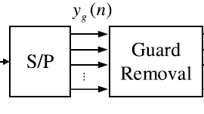
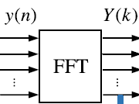
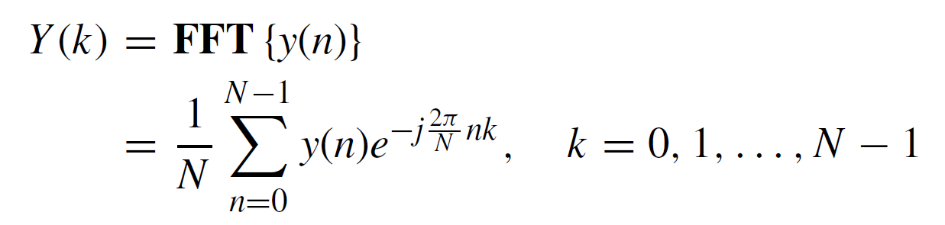
The received signal is split into parallel subcarriers.
Then cyclic prefix is removed out.
The time-domain signal y(n) is transformed to frequency-domain signal Y (k) by FFT
Under the assumption that the ISI is completely eliminated, the received signal can be formulated as:

Slide 16
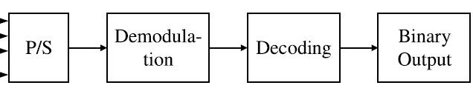
The compensated signal after channel estimation is congregated into a serial sequence
Which is then demodulated and decoded by the corresponding methods in the transmitter.
At this point, the output of UWA-OFDM system model is obtained as the final binary data sequence.

Slide 17
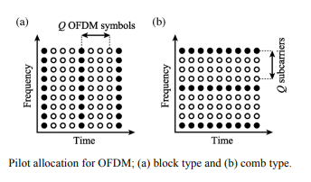
Pilot Insertion
A pilot symbol is a complete OFDM symbol where the value of each subcarrier is predefined and known in transmitter and receiver.
It is repeated with a certain rate that depends on how fast the channel changes.
The received signal is correlated with the pilot symbol to detect the OFDM symbol start.
Results have been obtained by using both block type and comb type pilot signals for different channel estimation techniques.

Slide 18
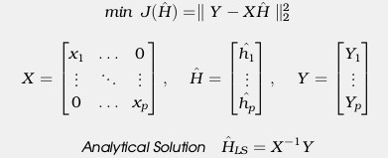
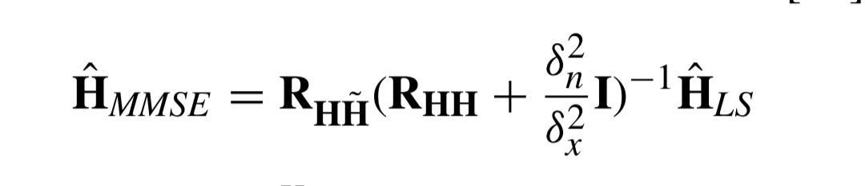
Channel Estimation Methods
Least Square Method
Least Square estimation is the euclidean distance between the received signal and the original signal.
Minimum Mean Square Error Method
Estimates the channel response by applying them to various M-QAM modulations
MMSE channel Estimation is given by

Slide 19
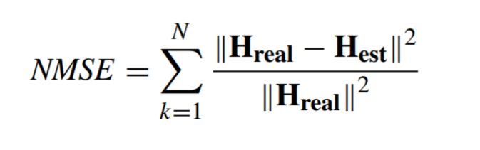
Normalized Mean Square Error Method
The Normalized Mean Square Error (NMSE) is a measure of the mean relative scatter and reflects the random errors
The normalization of the MSE assures that the metric will not be biased when the model overestimates or underestimates the predictions

Slide 20
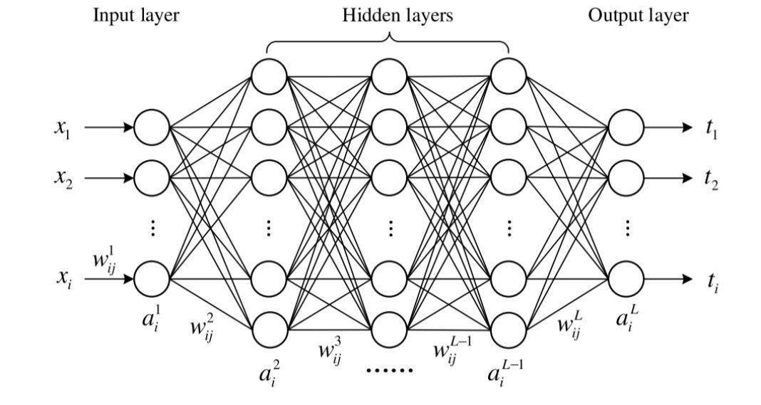
Deep Neural Networks
Typical architecture of deep neural network model
It consists of an input layer, multiple hidden layers, and an output layer
The neurons in the two adjacent layers are fully connected, whereas the neurons in each layer are not connected.

Slide 21
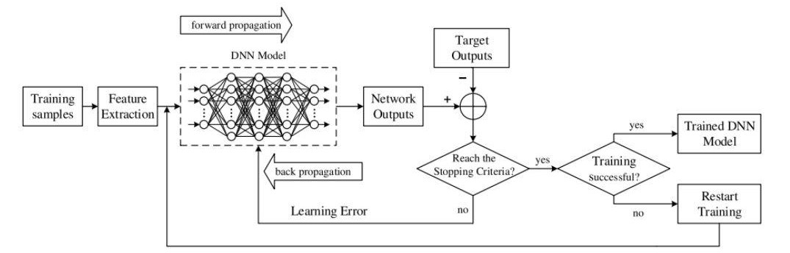
Training process of the proposed DNN models.
The objective of training a DNN is to find the optimal parameters of weights and biases to minimise the error between the network outputs and the target outputs.

Slide 22
Conclusion
We developed OFDMI Model and Bellhop Ray Model for Underground Acoustic environment
Channel Estimation using Least Square method and Minimum Mean Square Error Method
Deep Neural net models,termed DNN -1 and DNN-2 Layers are proposed for channel estimation
According to Results,our Proposed DNN models outperform conventional LSE method and more effective and have close performance compared to MMSE Method.
.

Slide 23
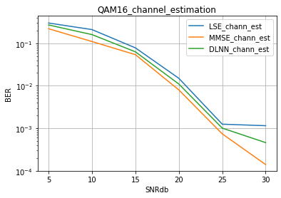
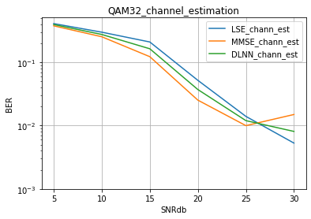
Previous Outcomes

Slide 24
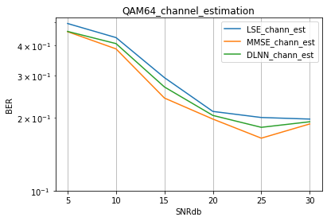
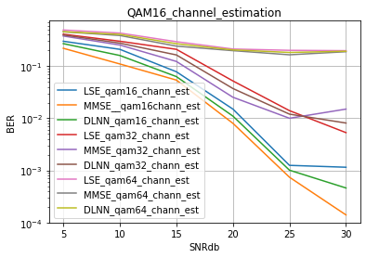
Previous Outcomes

Slide 25
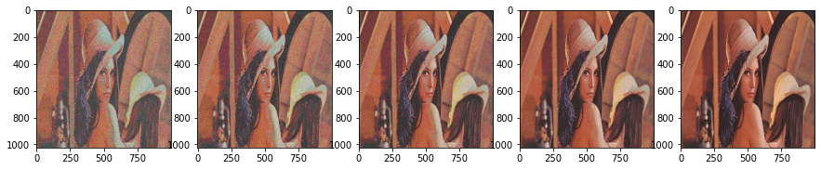
Comparison Between LS,MMSE and DNN1,DNN2 Methods QAM-16
LS Method
MMSE Method

Slide 26


Comparison Between LS,MMSE and DNN1,DNN2 Methods QAM-16
DNN1
DNN2

Slide 27
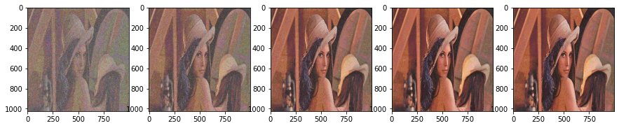
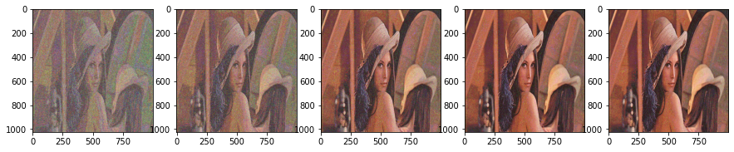
Comparison Between LS,MMSE and DNN1,DNN2 Methods QAM-32
LSE Method
MMSE Method

Slide 28
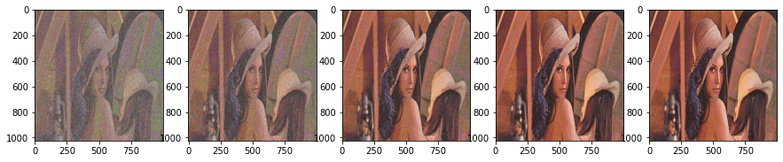

Comparison Between LS,MMSE and DNN1,DNN2 Methods QAM-32
DNN1
DNN2

Slide 29
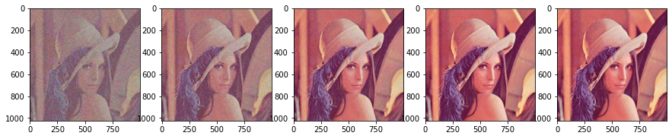
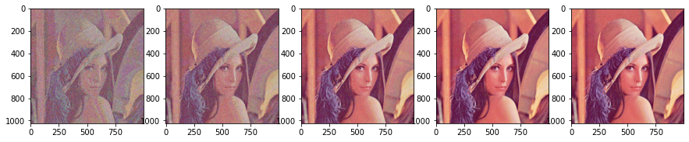
Comparison Between LS,MMSE and DNN1,DNN2 Methods QAM-64
LSE Method
MMSE Method

Slide 30
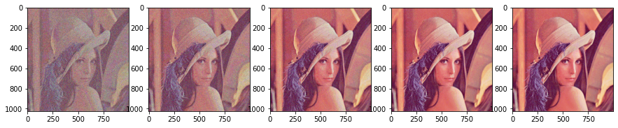

Comparison Between LS,MMSE and DNN1,DNN2 Methods QAM-64
DNN1
DNN2

Slide 31
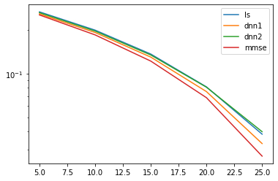
Outcomes
Comparsion of BER - QAM 16

Slide 32
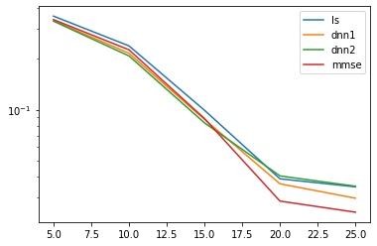
Outcomes
Comparsion of BER - QAM 32

Slide 33
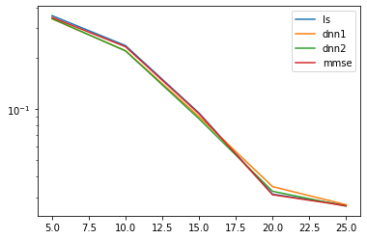
Outcomes
Comparsion of BER - QAM 64

Slide 34
References
J. Preisig, ‘‘Acoustic propagation considerations for underwater acoustic communications network development,’’ ACM SIGMOBILE Mobile Comput. Commun. Rev., vol. 11, no. 4, pp. 2–10, Oct. 2007.
M. Stojanovic and J. Preisig, ‘‘Underwater acoustic communication channels: Propagation models and statistical characterization,’’ IEEE Commun. Mag., vol. 47, no. 1, pp. 84–89, Jan. 2009.
R. Diamant and L. Lampe, ‘‘Low probability of detection for underwater acoustic communication: A review,’’ IEEE Access, vol. 6, pp. 19099–19112, 2018.
G. Qiao, Z. Babar, L. Ma, S. Liu, and J. Wu, ‘‘MIMO-OFDM underwater acoustic communication systems—A review,’’ Phys. Commun., vol. 23, pp. 56–64, Jun. 2017.
T. Lufen and X. Xu, Digital Underwater Acoustic Communications, 1st ed. New York, NY, USA: Academic, 2017.

